Slide 1
ANDROID APPLICATION
Vijay Sehgal
1812390
CSE 4th Year

Slide 2

COMPANY PROFILE
LearnSocial, is a growing team of Engineers, Management Graduates and Instructors looking to educate people, change their way of learning and help bridge the gap between what people learn and what exactly they need to be a pioneer in their life.
“To Succeed in a mission, you must have Single Minded Devotion to your Goal!!! – Dr A.P.J. Abdul Kalam"

Slide 3
CONTINUE…
LearnSocial is an e-learning marketplace where anyone can learn anything, and anyone with a substantial command over any skillset can host and teach their courses.
The idea behind LearnSocial’s foundation is to provide quality education to anyone, wherever they are and at their comfort. The categories of courses span across IT, Business, Academic, Languages, Art & Creativity, Exam Prep and LifeStyle.
The courses are offered in the Instructor Led Online Live format (live classes) and Self-Paced format (recorded videos).
LearnSocial has gained significant traction in the online learning marketplace model.

Slide 4
LANUAGE: ANDROID(Java, XML & SQLite)
Java is both a programming language and a platform.
Earlier it was called “Oak”.
It is a high level language which has following Features:
Simple
Object Oriented
Distributed
Interpreted
Robust
Secure
Portable
Multithreaded

Slide 5
CONTINUE…
XML stands for Extensible Markup Language and is a text-based markup language derived from Standard Generalized Markup Language (SGML).
XML carries the data, does not present it: XML allows you to store the data irrespective of how it will be presented.
XML is a public standard: XML was developed by an organization called the World Wide Web Consortium (W3C) and is available as an open standard.

Slide 6
CONTINUE…
SQLite is an in-process library that implements a self-contained, Serverless, zero-configuration, transactional SQL database engine.
SQLite is the most widely deployed database in the world with more applications than we can count, including several high-profile projects.
SQLite is an embedded SQL database engine. Unlike most other SQL databases, SQLite does not have a separate server process. SQLite reads and writes directly to ordinary disk files.
The database file format is cross-platform - you can freely copy a database between 32-bit and 64-bit systems or between big-endian and little-endian architectures.
SQLite is a compact library

Slide 7
HISTORY OF ANDROID
Android Inc. founded in Palo Alto, california ,united states in October 2003 by Andy Rubin co-founder of danger ,rich miner co-founder of wildfire communication Inc., nick searsonce VP at T-mobile,
and Chris white headed design and interface development at web TV to develop.

Slide 8
WHAT IS ANDROID?
It is a open source software platform and operating system for mobile devices
Based on the Linux kernel
Developed by Google and later the Open Handset Alliance (OHA)
Allows writing managed code in the Java language
Android has its own virtual machine i.e. DVM(Dalvik Virtual Machine),which is used for executing the android application.
Google purchased the initial developer of the software , android incorporated in 2005.

Slide 9
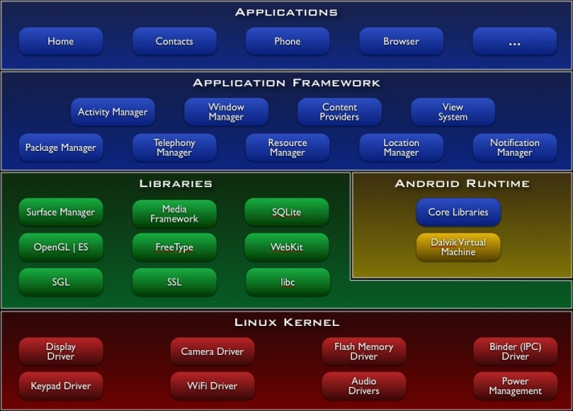

Slide 10
OPEN SOURCE
Developers
Android provides all the tools and frameworks to allow easy and quick development of mobile apps. Android SDK is all you need to start developing for Android - you don’t even need a physical phone.
Developer have access to entire platform source code. This allows you to see how the guts of Android operating system work.
User
Android just works right out of the box. Additionally, users can substantially customize their phone experience.
Manufacture
It is the complete solution that can run their devices. Other than some hardware-specific drivers, Android provides everything else to make their devices work.
can easily port Android OS to your specific hardware
You can also add your own proprietary secret sauce and you do not have to push it back to the development community if you don’t want to

Slide 11
ADVANTAGES/BENEFITS
Android was designed to run on all sorts of physical devices.
Android doesn’t make any assumptions about a device’s screen size, resolution, chipset, and so on. Its core is designed to be portable.

Slide 12
PROJECT DETAILS
PeopleNet – It is the twitter based app with 140 characters limitation and the counter is set in built. In this the user can post and view his posts as timeline view in the form of list view.
Google Maps Integration – Google Maps is integrated with the help of Google Cloud Console and the user can come to know his location with location manager and GPS technology.
WhereAmI – It is the location based app with longitude and latitude shown inside the application.

Slide 13
Getting Google Maps API Key
Same as in maps v1 we need to generate SHA-1 fingerprint using java keytool. Open your terminal and execute the following command to generate SHA-1 fingerprint.
On Windows
keytool -list -v -keystore "%USERPROFILE%\.android\debug.keystore" -alias androiddebugkey -storepass android -keypass android
On Linux or Mac OS
keytool -list -v -keystore ~/.android/debug.keystore -alias androiddebugkey -storepass android -keypass android

Slide 14
PROJECT DESC
Intents
Activity
Location Manager
Google Play Services
Google Developer Console
Notification Manager
Views, Content Providers & Receivers
Adapters and list

Slide 15
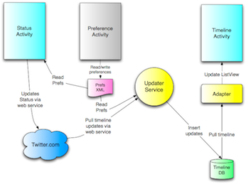
DATA FLOW DIAGRAM

Slide 16
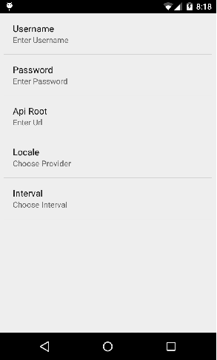
OUTPUT: Initial App Screen

Slide 17
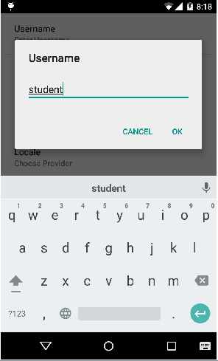
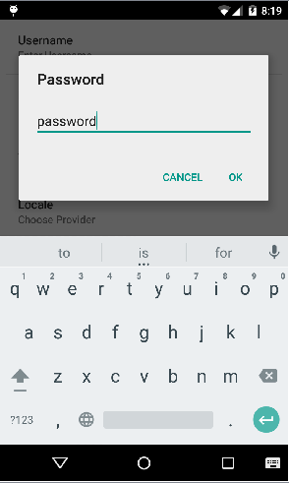
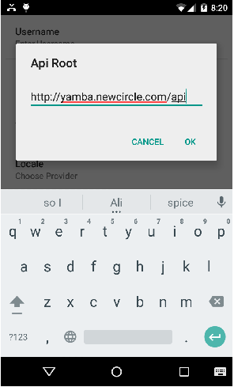
Username, Password, API Root

Slide 18
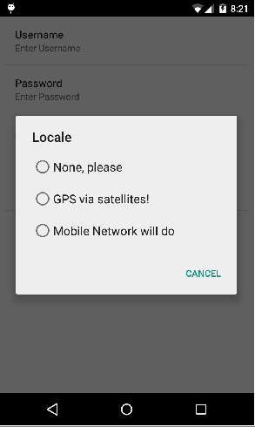
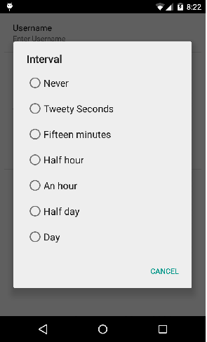
Local Network & Interval

Slide 19
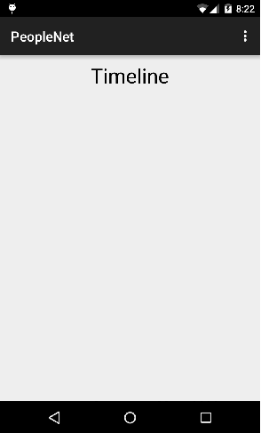
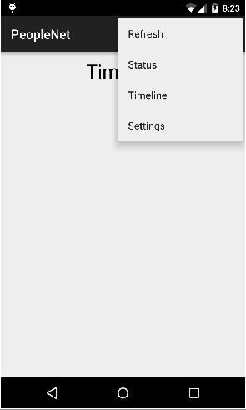
Timeline & Option Menu

Slide 20
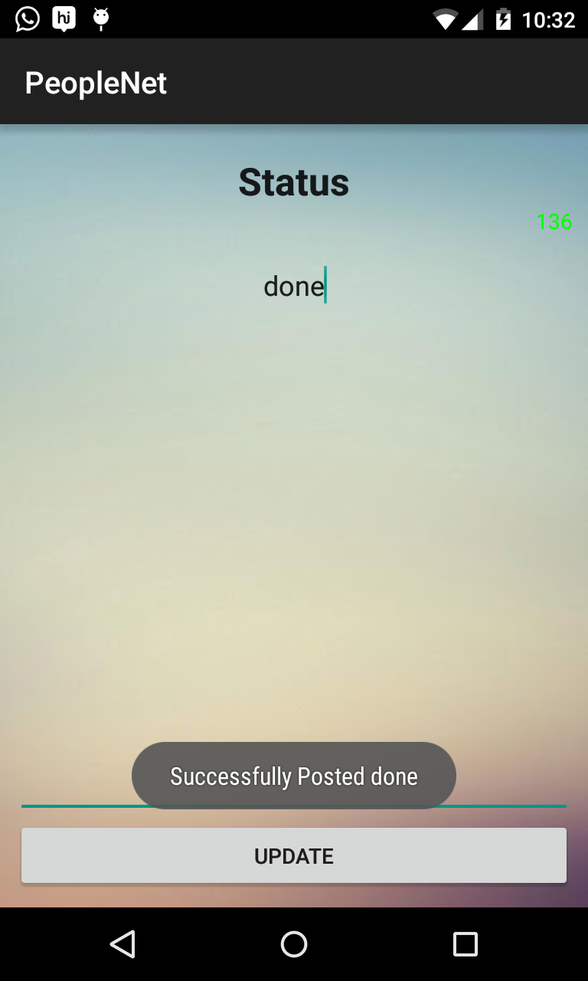
Status Activity

Slide 21
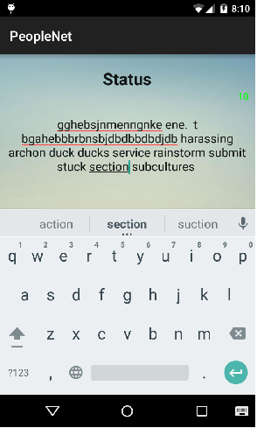

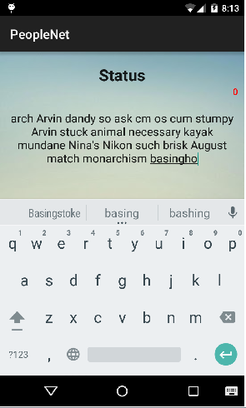
Use of Counter

Slide 22
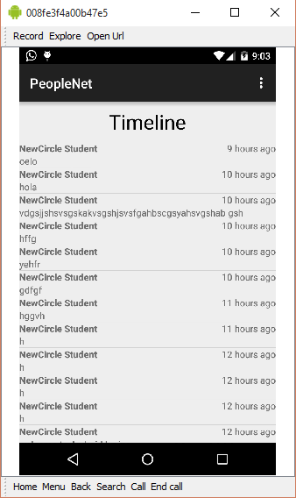
Timeline View

Slide 23
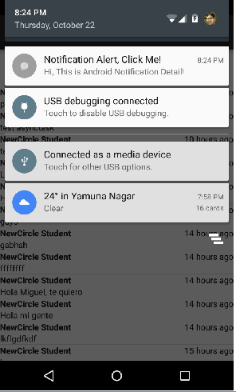
Notification View

Slide 24
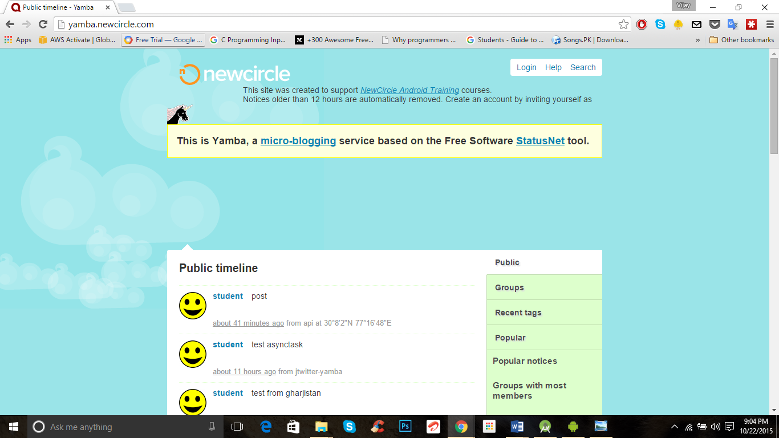
Yamba Client Website

Slide 25
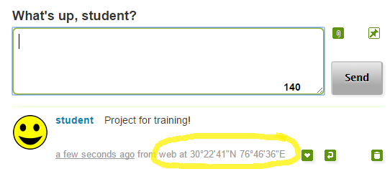
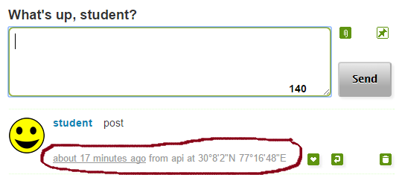
Yamba Site Status Update

Slide 26
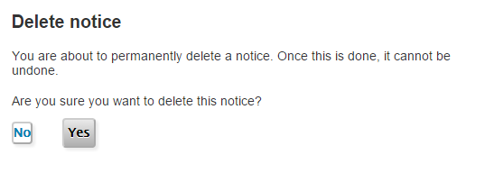
Delete Post

Slide 27
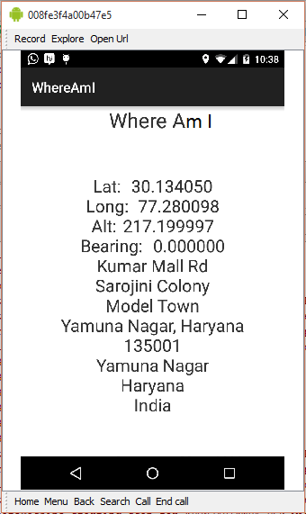
WhereAmI

Slide 28
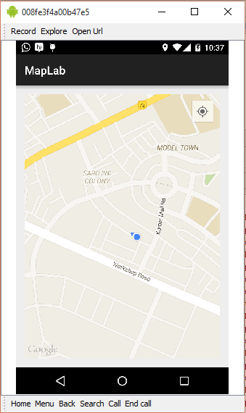
Google Maps Integration

Slide 29
FUTURE SCOPE
This project is a live project so it can only run on a live device not on an emulator.
This project will only work after the entering the credentials at the initial screen otherwise error toast will be displayed to the user.
But the user can still view his timeline by clicking on the options menu and the refreshing the app.
One can still be shown the notification of it.
WhereAmI is the another part of the project in order to know the latitude and longitude concept in detail.
Google Maps is a really a great thing to implement on the device with the fragment view.
This helps user to know his current location.

Slide 30
CONCLUSION
I have successfully implemented this project. With the help of various tools like Android Studio and Eclipse As well as the SQLite database with is server less and also the Yamba client and for the implementation of Google Maps Google Cloud Platform is to be used. Without this no one can implement Google Maps. The use of Key and the Google Play Services should be enabled on the device in order to implement it. The Key is Public it can be used in any other project without generating it again and again

Slide 31
REFERENCE
https://developer.android.com
http://www.tutorialspoint.com/android
http://yamba.newcircle.com/
https://www.learnsocial.com

Slide 32
THANK YOU
Q/A

